Slide 1

PROBABILITY THEORY AND DATA MINING
First step to
Becoming
A data scientist

Slide 2
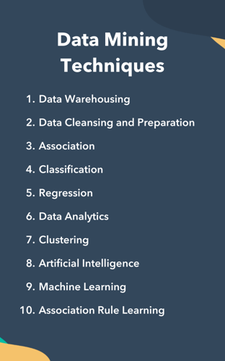
Introduction to probability
Probability and Statistics
Basic Concepts
Rules
Conditional Probability
Bayes Theorem

Slide 3
Probability distributions
Random Variables
Bernoulli Distribution
Binomial Distribution
Normal Distribution
Central Limit Theorem
Mathematical Expectation
Computer simulation

Slide 4
Statistical Analysis
Descriptive Statistics
Inferential Statistics
Computer simulation

Slide 5
IBM SPSS statistics
Introducing IBM SPSS
Descriptive Statistics in SPSS
Computer simulation
Hypothesis Testing
Computer Simulation

Slide 6
Independence
Concepts
Computer Simulation
Odds Ratios
Chi Square Test
Fisher Exact Test
T Independent Test
Two-Sample T-Test

Slide 7
Variance Analysis
Concepts and Implications
Computer Simulation
Follow-up Test
Two-Way ANOVA
Understanding Covariance Test
Steps to Implementing Covariance Test

Slide 8
Round up topics in statistics
Correlation Test
Non-Parametric Test
AB Test
Computer Simulation
Final Statistics Project

Slide 9
Data Mining Introduction
Introducing Data Mining
Data Description and Data Mining Methods
SPSS Modeler Introduction
Data Entry in SPSS Modeler
Data Quality
Handling Out of Range Data
Handling Outliers and Missing Data

Slide 10
Data transformation
Data Normalisation
Feature Creation
Discretisation
Data Aggregation
Data Smoothing
Computer Simulation

Slide 11
Dimensionality reduction
Feature Selection
Feature Extraction
Sampling
Data Integration
Project: Analysing Customer Behaviour

Slide 12
Rule based Predictive models
Introducing Predictive Models
Decision Tree
Rule Assessment and Interpretation
Classification Model Assessment
Regression Model Assessment

Slide 13
Unbalanced Data
Challenges in Handling Unbalanced Data
Implementing Decision Tree
Confusion Matrix
Regression Tree in SPSS

Slide 14
Statistical predictive models
Naïve Bayes
Linear Regression
Parameter Estimation
Model Hypothesis Tests
Implementing Linear Regression
Logistic Regression
Implementing Logistic Regression

Slide 15
Ensemble predictive models
Introducing
Stacking
Bagging
Boosting
Implementing Ensemble Learning in Classification
Implementing Ensemble Learning in Regression

Slide 16
Unsupervised Learning
Introducing Clustering
Hierarchical Clustering
K-Means Algorithm
DB-SCAN Algorithm
Association Rules
Apriori Algorithm

Slide 17

NOTES
WEBSITES
Prerequisites
Depends On Instructor
None
TEXTS
Depends On Instructor
Suggested Time
70 Hours

Slide 18

Document History
Author | Version | Revision | Date / Time | Department | Validity
Mehdi Shokri | 1.0.0 |  | 14-05-2023 | AI | 3 Months

